Slide 1

HOSA
Future Health Professionals

Slide 2

Follow our Instagram
phuhs_hosa
Communication
Join the Remind
Hosalow26 (freshmen and sophomores ONLY)
Hosaup26 (juniors and seniors ONLY)

Slide 3

Dues
Being in HOSA requires a $50 due that covers region, state, national, and chapter dues for the school year
Dues must be paid by 8/30 on Revtrak
Dues include a club T- shirt

Slide 4

These will all be held in the TA after school
September 10th October 18th November 12th December 10th January 14th February 11th
March 11th
April 8th
Meeting Dates

Slide 5
Empower future health professionals to become leaders in the global health community through:
Mission
Education
Collaboration
Experience

Slide 6

Develop leadership & technical skill competencies through a program of:
Purpose
Motivation
Awareness
Recognition
All integral parts of Health Science Education programs

Slide 7
- Leadership
Core Values
Service
Learning
Innovation

Slide 8

Executive Board Positions Current lower chapter positions
open:
VP
President-Elect (freshman only)
Secretary Historian Treasurer
Leadership
Parliamentarian Letter of Intent due: 8/30 send to patek@pcsb.org Committee Chair Positions
Regional & State Officer Positions

Slide 9
- HOSA Service Project (NMDP)
Service
Glam Run
Kimberly Home
-Barbara James
Service Award

Slide 10

- Through competitions
- At monthly meetings, 2nd Wednesday of every month
- With guest speakers Collaboration w/health care professionals
NEW THIS YEAR!! : Health
Learning
Occupation Seminars
₃rd
Wednesday of every month

Slide 11
Seek knowledge & skills to address challenges & improve the health professions
Innovation

Slide 12


- Regional, State, International Levels
Competition
-Top 3 winners in each category advance at each level
-Over 55 competitive event categories

Slide 13
Regional Competition: Middleton High School
Competition
1 day January
State Competition: Marriott World Center
½ days April
International Competition:
½ days June 2026: Indianapolis

Slide 14
Health Science Events Examples:
Competition
Dental Terminology
Medical Reading
Medical Math
-Human Growth & Development
Pharmacology
- Nutrition

Slide 15
Health Professions Events Examples:
Competition
-Biomedical Laboratory Science
Nursing Assisting
Physical Therapy
Sports Medicine
Veterinary Science

Slide 16
Emergency Preparedness Event Examples:
Competition
- CPR/First Aid
EMT
Epidemiology
CERT Skills

Slide 17
-Extemporaneous Health Poster
Leadership Event Examples:
Competition
Extemporaneous Writing
Healthy Lifestyle
Prepared Speaking

Slide 18
Teamwork Event Examples:
Biomedical Debate
-Creative Problem Solving
Forensic Science
Health Education
-Public Service Announcement
Competition

Slide 19
Recognition Event Examples
Competition
Healthcare Issues Exam
HOSA Service Project
HOSA Happenings
-Barbara James Service Award
-Outstanding HOSA Chapter

Slide 20
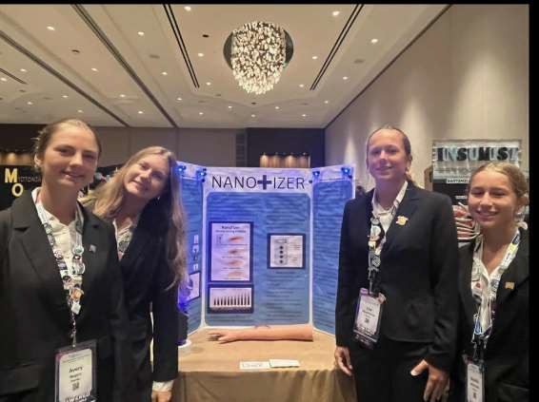
2025 International Competition: Avery Rodgers, Sara Dominczak, Lisa Muehfellner, Maddie Maldonado
– Medical Innovation

Slide 21


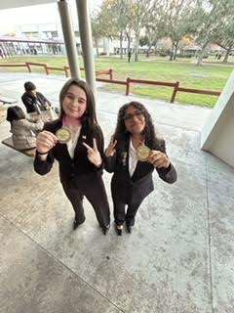
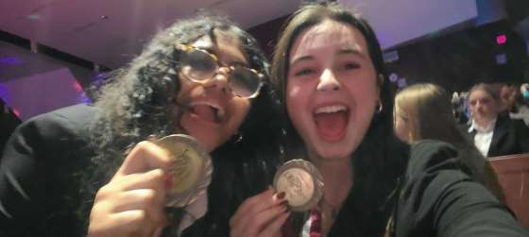
2025 Regional Competition: Jessica Killeny & Audree
Thurman – Forensic Science

Slide 22
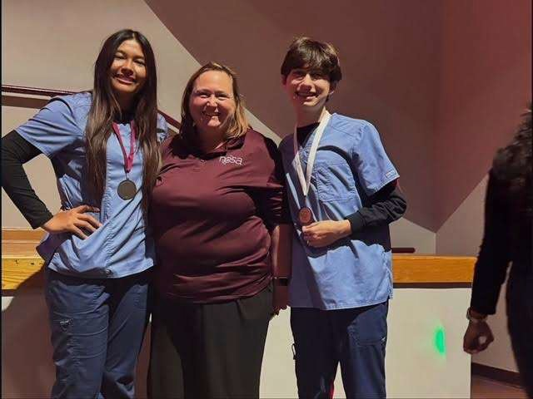
2025 Regional Competition: Ryla Alabat & Micheal Zollo – Pharmacy Science

Slide 23
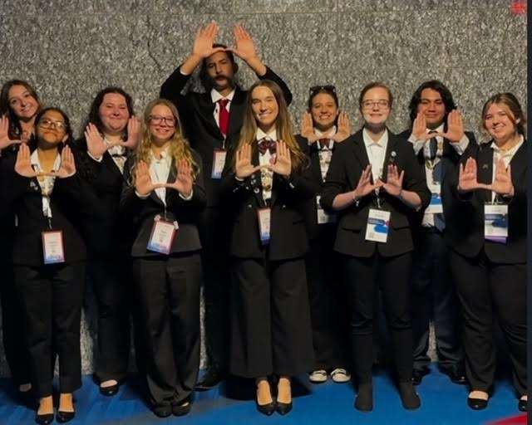
2024 International Competition (left to right): Kaelyn McDaniel, Jessica Killeny, Kennedy Gallagher, Rae Daniels, Yassin Elsammak, Ena Ibrahimovic, Shyla McGowen, Kennedy Bolen, Ethan Tran, Briana Pate

Slide 24

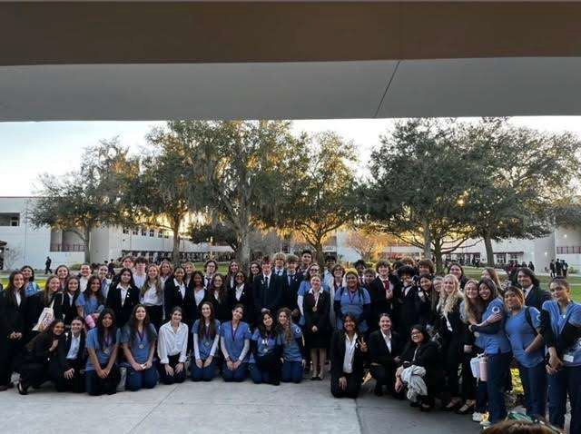
2024 Regional Competitors from PHUHS

Slide 25
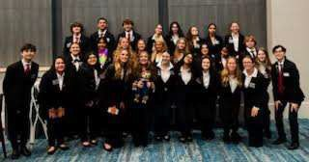
2025 State Competitors from PHUHS

Slide 26
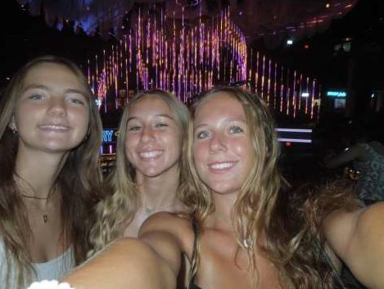
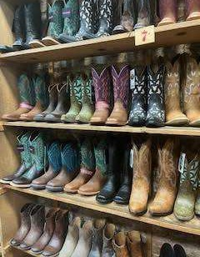

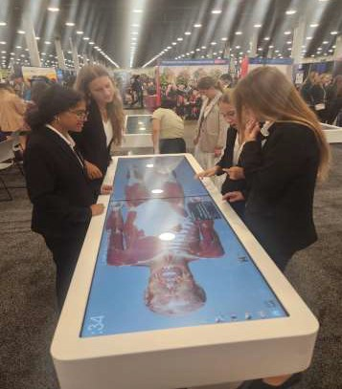


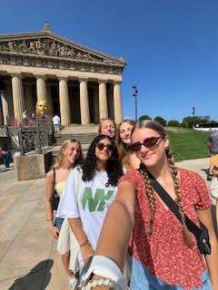
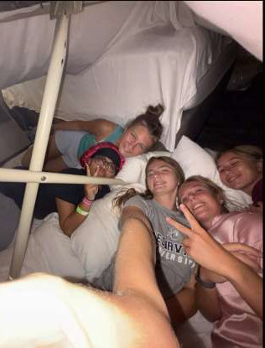
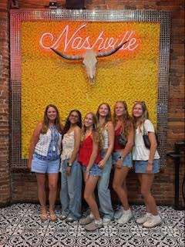
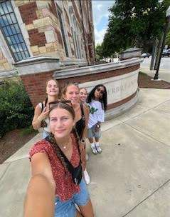
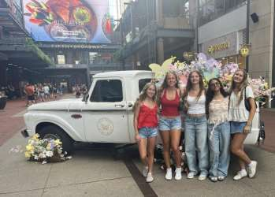

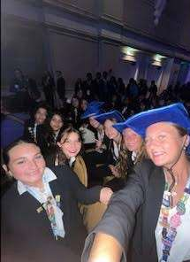
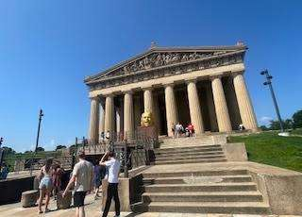
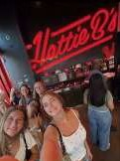
2025 International Competition at Nashville w/PHMS!!

